Slide 1
Implementation Part Presentation of chosen theses for CSE 596 course. Part 1
Theses- Using PLM(Pretrained Language Models) for Toxic Comment Classification
Group 5
Members-
Md. Sayadul Hoque (2235106650)
Moinul Hasan Sifat(2235015650)
Bristy Cathrin(2235366650)
Muntaka Sayef(2235082650)

Slide 2
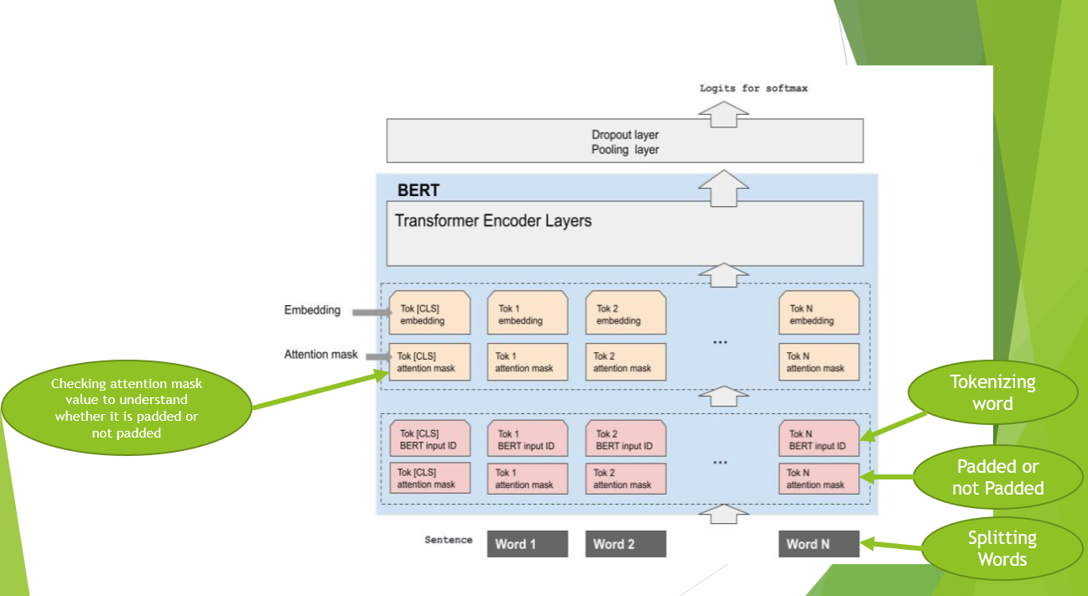
BERT

Slide 3
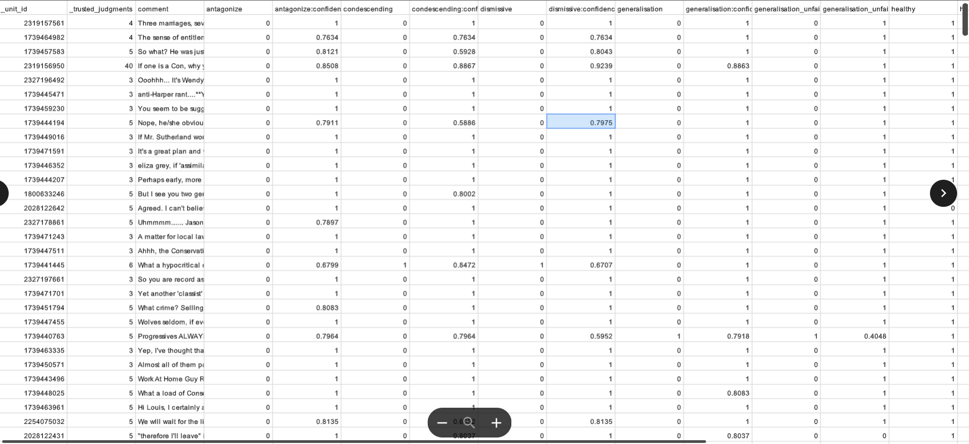
Training Dataset

Slide 4
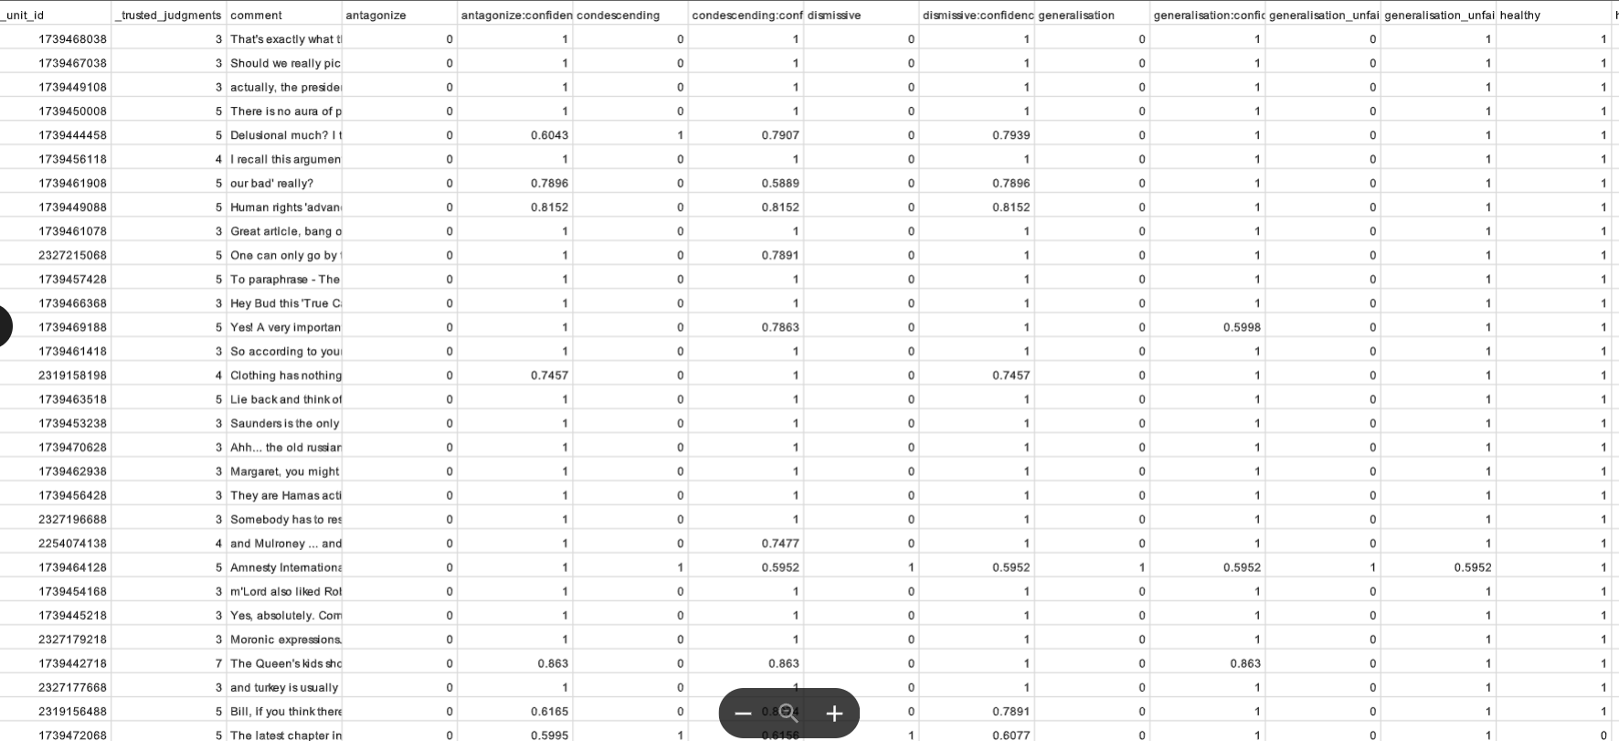
Validation Dataset

Slide 5
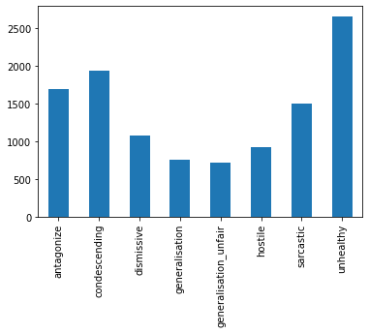
Training Data Inspection

Slide 6
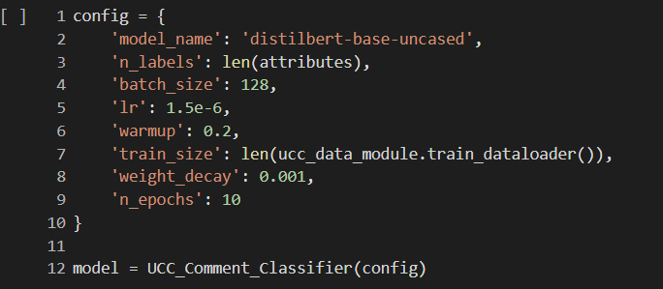
Configuration

Slide 7
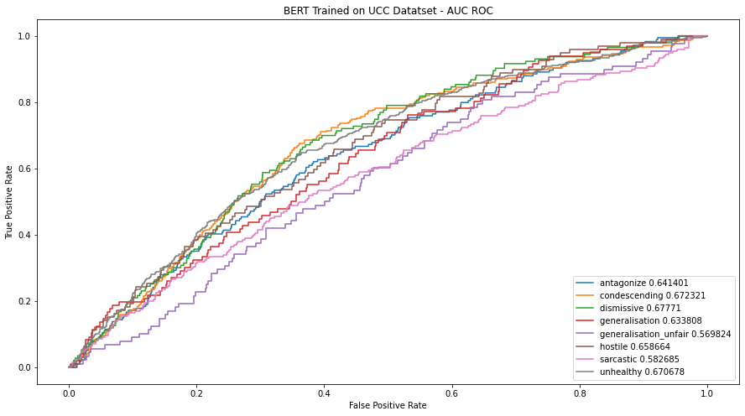
Using BERT for Toxic Comment Classification

Slide 8
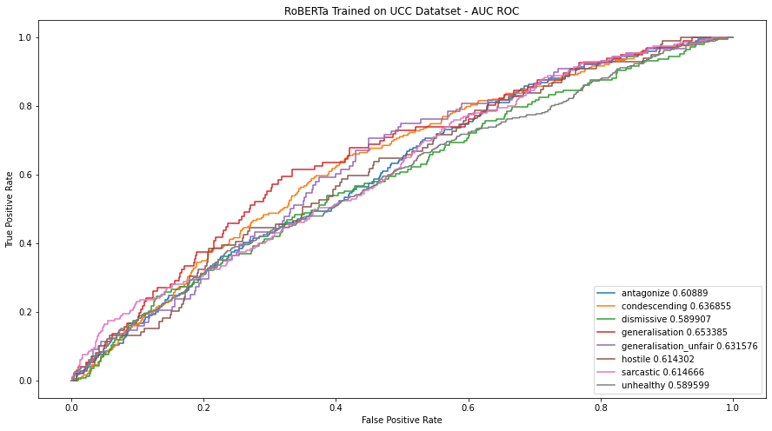
Using RoBERTa for Toxic Comment Classification

Slide 9
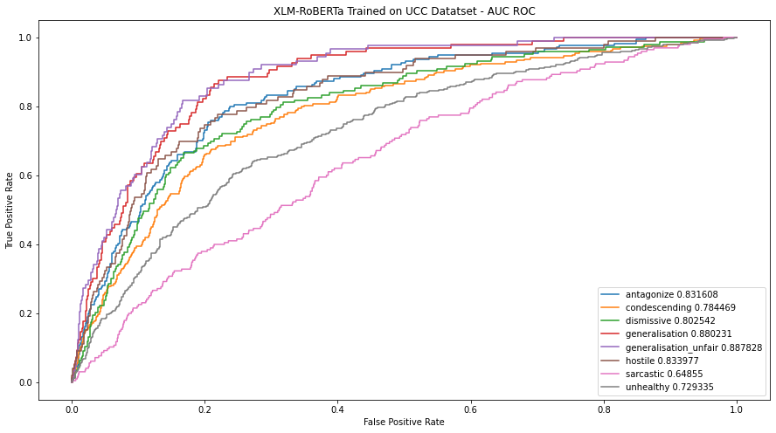
Using XLM-RoBERTa for Toxic Comment Classification

